Slide 1
CSO-Recitation 02 CSCI-UA 0201-007
R02: GCC & Makefiles & Test

Slide 2
Today’s Topics
Mini quiz in last week
Compiling with gcc
Makefiles
Testing code

Slide 3
Mini quiz - Q1
Facebook has 2.7 billion users. If it is to use an unsigned int as user-id, what's the smallest sized int can it use?
A. 1-byte B. 2-byte C. 3-byte D. 4-byte E. 8-byte

Slide 4
Mini quiz - Q1
Answer: D. 4-byte
3 bytes = 24 bits, range: 0 ~ 2^24 - 1
4 bytes = 32 bits, range: 0 ~ 2^32 - 1
2^24 - 1 < 2.7 * 10^9 < 2^32 – 1

Slide 5
Mini quiz - Q2
Which of the following signed 1-byte int (in binary format) is the smallest?
A. 00000000 B. 10000001 C. 11111111
D. 00000001 E. 10000011 F. 01111110

Slide 6
Mini quiz - Q2
Answer: B. 10000001
For signed int, convert it into a decimal number:
For i-th bit, (i-th bit) * (+/- 2^i).
highest bit: *(-2^i), others: *(+2^i)
Smallest:
Highest bit is 1
For other bits(positive), pick the smaller one

Slide 7
Mini quiz - Q3
Convert bit pattern 10111110 to hex notation. You must prefix your answer with 0x.

Slide 8
Mini quiz - Q3
Answer: 0xbe
10111110
1011 1110
1011 = b, 1110 = e

Slide 9
Mini quiz - Q4
Which of the following 1-byte unsigned subtraction operation will overflow?
A. 0xff – 0x0f B. 0x0f – 0xff C. 0x01 – 0x0f D. 0x0f - 0x01

Slide 10
Mini quiz - Q4
Answer: B. 0x0f – 0xff, C. 0x01 – 0x0f
Overflow: when the result is out of the range of the representation
8-bit unsigned range: 0 ~ 2 ^ 8 – 1
For unsigned operation:
Case 1: when the result is negative
Case 2: when the result is positive but too large ( > 2^8 – 1 in this question)

Slide 11
Mini quiz - Q5
Which of the following 1-byte signed addition operation will overflow?
A. 0xff + 0xfe B. 0x1f + 0xff C. 0x71 + 0x70
D. 0x05 + 0xfe E. 0x80 + 0x8f

Slide 12
Mini quiz - Q5
Answer: C. 0x71 + 0x70, E. 0x80 + 0x8f
Overflow: when the result is out of the range of the representation
8-bit signed range: - 2^7 ~ 2^7 – 1
For signed operation:
Case 1: adding two positive numbers, but the MSB of the result is 1 (negative)
Case 2: adding two negative numbers, but the MSB of the result is 0 (positive)
Case 1 & Case 2: for adding numbers with the same signs, overflow <=> MSB is incorrect
Note: overflow wouldn't happen if you add a negative number and a positive number.
Why?

Slide 13
Mini quiz - Q6
If x has bit pattern 0xffffffff, what's the value of x?
A. -1, if x is signed int
B. -1, if x is unsigned int
C. 2^32 – 1, if x is unsigned int
D. 2^31 – 1, if x is unsigned int

Slide 14
Mini quiz - Q6
Answer: A. -1, if x is signed int. C. 2^32 – 1, if x is unsigned int

Slide 15
Mini quiz - Q7
What's the bit pattern (2's complement) of 32-bit signed integer -130 in hex format? (Please prefix your answer with 0x)

Slide 16
Mini quiz - Q7
Answer: 0xffffff7e
130 = 16 * 8 + 2: 0000 0000 0000 …. 1000 0010
0000 0000 0000 …. 1000 0010
-> (flip) 1111 1111 1111 …. 0111 1101
-> (+1) 1111 1111 1111 …. 0111 1110 = 0xffffff7e

Slide 17
Mini quiz - Q8
Suppose the byte values stored at memory address a, a+1, a+2, a+3, a+4, a+5, a+6, a+7 are 0x01, 0x02, 0x03, 0x04, 0x05, 0x06, 0x07, 0x08 respectively. If a Little-Endian processor is to load a 4-byte integer from memory at address a into a 4-byte register, what's the 4-byte register value after the load? (Please write your answer in hex, and prefix it with 0x)

Slide 18
Mini quiz - Q8
Answer: 0x04030201
0x08
0x07
0x06
0x05
0x04
0x03
0x02
0x01
Little endian: 0x04030201
Big endian: 0x01020304
a+ 3
a+ 2
a+ 1
a

Slide 19
Reminder
Your second weekly mini-quiz
Gradescope
Due Friday 9pm EST

Slide 20
Compiling
The basics of GCC

Slide 21
GCC
GCC (upper case) refers to the GNU Compiler Collection
This is an open source compiler suite which include compilers for C, C++, Objective C, Fortran, Ada, Go and Java
gcc (lower case) is the C compiler in the GNU Compiler Collection

Slide 22
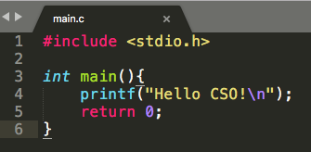
What is a compiler?
C code is for people, not computers
In fact, high level languages in general are for people
Computer processors only “understand” binary instructions
Machine code
(binary instructions)
Source code
Source file: the file containing source code (aka all ".c" files)
Executable file: the file containing machine code

Slide 23


What is a compiler?
C code is for people, not computers
In fact, high level languages in general are for people
Computer processors only “understand” binary instructions
A compiler translates code between languages
In our cases, it translates from C (the source language) to machine code (the target language)
Text editor
Compiler
edit
Source file
compile
Executable file
execute
(C code)
(machine code)

Slide 24
What is a compiler?
C code is for people, not computers
In fact, high level languages in general are for people
Computer processors only “understand” binary instructions
A compiler translates code between languages
In our cases, it translates from C (the source language) to machine code (the target language)
An alternative way to do things is to have a program read the code and execute commands
Such a program is called an interpreter
Python is an example of a language that uses an interpreter

Slide 25
How do you use a compiler?
Consider a simple C program:
main.c
#include <stdio.h>
int main( ){
printf("Hello CSO!\n");
return 0;
}
To run this program, we must first compile it
Can use gcc: gcc main.c -o myprogram
A file named myprogram is generated
You can run it with ./myprogram

Slide 26
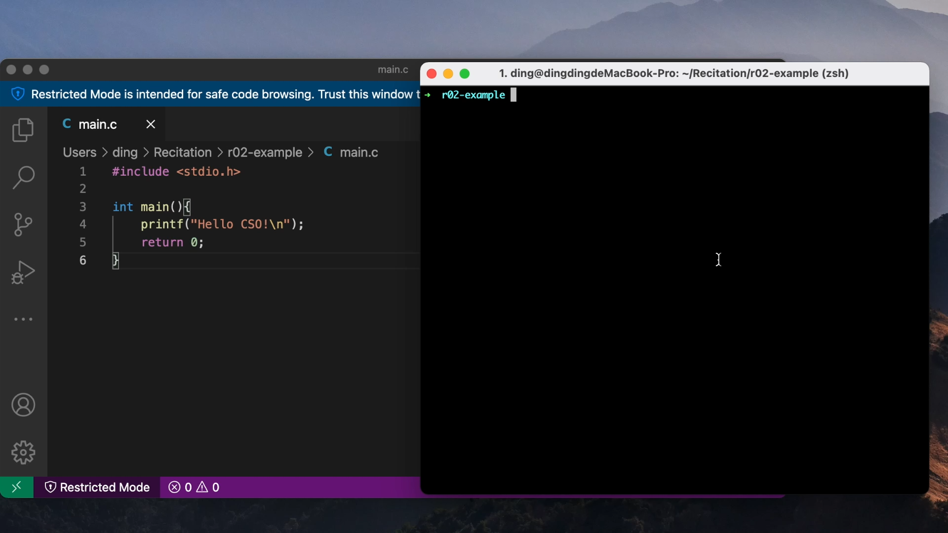
How do you use a compiler?

Slide 27
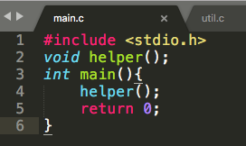
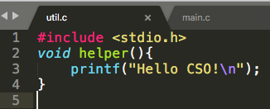
How do you use a compiler?
Sometimes you may want to spread the code into multiple file (e.g., the code is too large; or you want to divide it by functionalities)
To compile this, we can simply specify both files
gcc main.c util.c -o myprogram

Slide 28
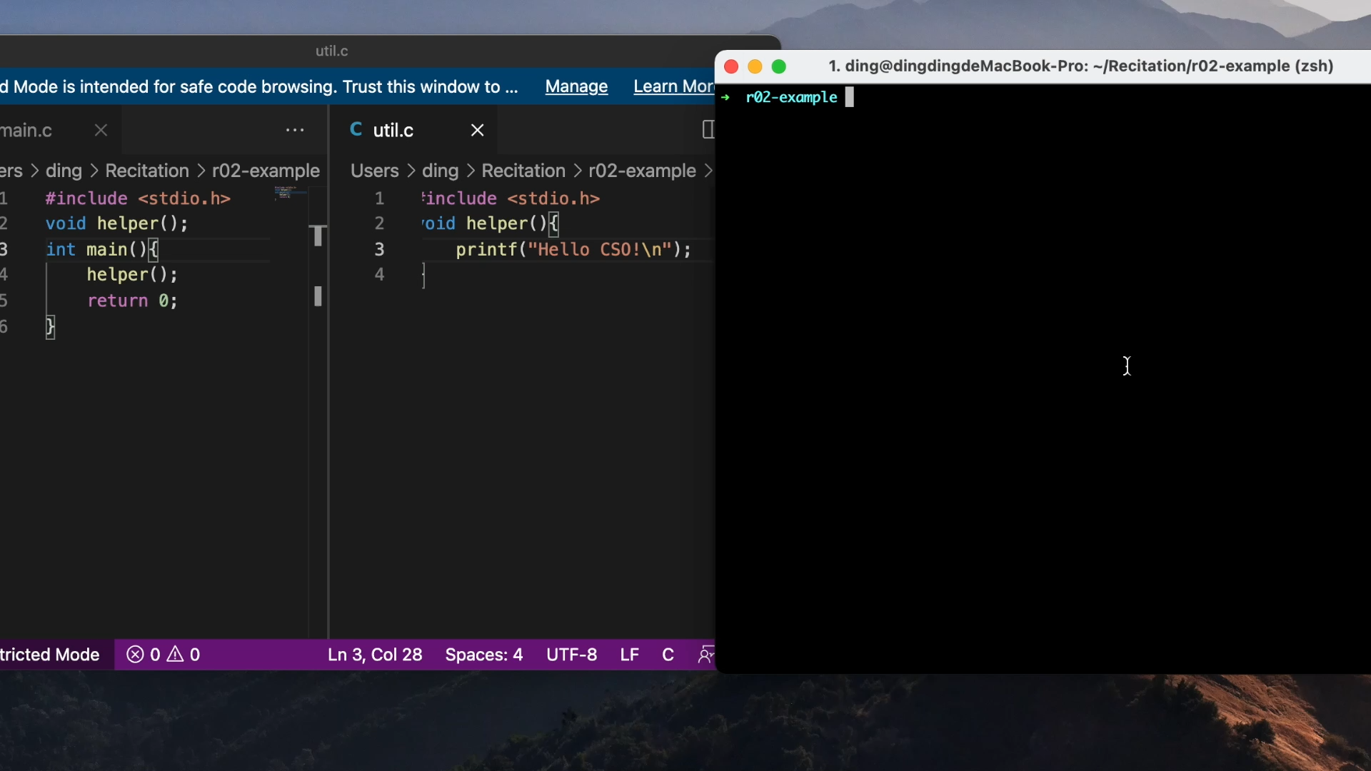
How do you use a compiler?

Slide 29
A Problem
gcc main.c util.c -o myprogram will process every source file
Even if we only change main.c, util.c is also processed
Problematic for large project (thousands of files), as reprocessing every file can be slow
Can we only re-process the changed one?
Yes! We can make the use of the object files (".o" files)

Slide 30
What's inside gcc main.c util.c -o myprogram?
Roughly two steps: compilation and linking
Compilation: For each source file (aka compilation unit), gcc creates a intermediate object file
Linking: creates a single executable file from multiple object files
Note: you won't see object files ordinarily as they are automatically deleted after linking
gcc main.c util.c -o myprogram
main.c
util.c
compile
main.o
util.o
link
myprogram
(C code)
(object code)
(machine code)

Slide 31
What's inside gcc main.c util.c -o myprogram?
We can run both steps separatly
To only run compilation: use the -c flag to stop before linking. It also preserve the intermediate object files
gcc -c main.c
will create main.o
gcc -c util.c
will create util.o
To only run linking:
gcc main.o util.o -o myprogram
will link main.o and util.o and create the executable file

Slide 32
Solution to the Problem
The problem: changing one file requires recompiling all other unchanged files, which are wasteful and slow
The cure:
use -c to create main.o and util.o
Every time main.c is changed, recompile it with gcc -c main.c and not have to recompile the other
Same when util.c is changed
We can later do link by running gcc main.o util.o -o myprogram

Slide 33
A new problem
Now we need to manually keep track of when and what files we have to recompile.
Too much trouble, and error-prone

Slide 34
Make
A helpful build automation tool

Slide 35
What does Make do?
Make builds (i.e. compiles) projects for us, keeping track of when it needs to recompile or not
We create a file named Makefile and write down a set of rules stating what to track
e.g., issue gcc -c main.c to generate main.o when main.c is changed
Then, by issuing the command make we can build our project,
next time you issue make, only the changed files will be recompiled

Slide 36
How do we specify rules in Makefile?
Makefile consists of a number of ‘rules’, each of which looks like:
target ... : dependencies ...
command
Target is usually the name of a file generated by the compiler
e.g., main.o, util.o, myprogram
Dependencies are files that are used as input to create the target
main.o needs main.c
myprogram needs main.o and util.o
Commands are actions that will be carried out
gcc -c main.c -o main.o

Slide 37
How do we specify rules in Makefile?
Makefile consists of a number of ‘rules’, each of which looks like:
target ... : dependencies ...
command
It specifies how to build target:
If target is already built (i.e. file existed) and up-to-date (i.e. modified later than all the dependency files), no actions are carried out
Otherwise, build each dependency first and then issue command
To build target, issue make target

Slide 38
How do we specify rules in Makefile?
An exmple :
myprogram: main.o util.o
gcc main.o util.o -o myprogram
It specifies the rule to build myprogram:
Build main.o and util.o first
Then issue "gcc …"
Similary we have rules for main.o and util.o:
main.o: main.c
gcc -c main.c -o main.o
util.o: util.c
gcc -c util.c -o util.o

Slide 39
How do we specify rules in Makefile?
Issue make myprogram to build myprogram
Try issuing it twice. You'll find that no actions are taken in the second run
Try changing main.c and issue make myprogram. You'll find that util.c is not compiled

Slide 40
How do we specify rules in Makefile?
target ... : dependencies ...
<TAB>command
Attention:
There must be no space before the target, and there must be a tab before every command for that rule
Running the make command builds the first target by default
A handy and commonly seen rule
clean:
rm -f main.o util.o myprogram
make clean is identical to "rm …" (but shorter) which removes all the files generated by the compiler

Slide 41
The overall Makefile
myprogram: main.o util.o
gcc main.o util.o -o myprogram
main.o: main.c
gcc -c main.c -o main.o
util.o: util.c
gcc -c util.c -o util.o
clean:
rm -f main.o util.o myprogram

Slide 42
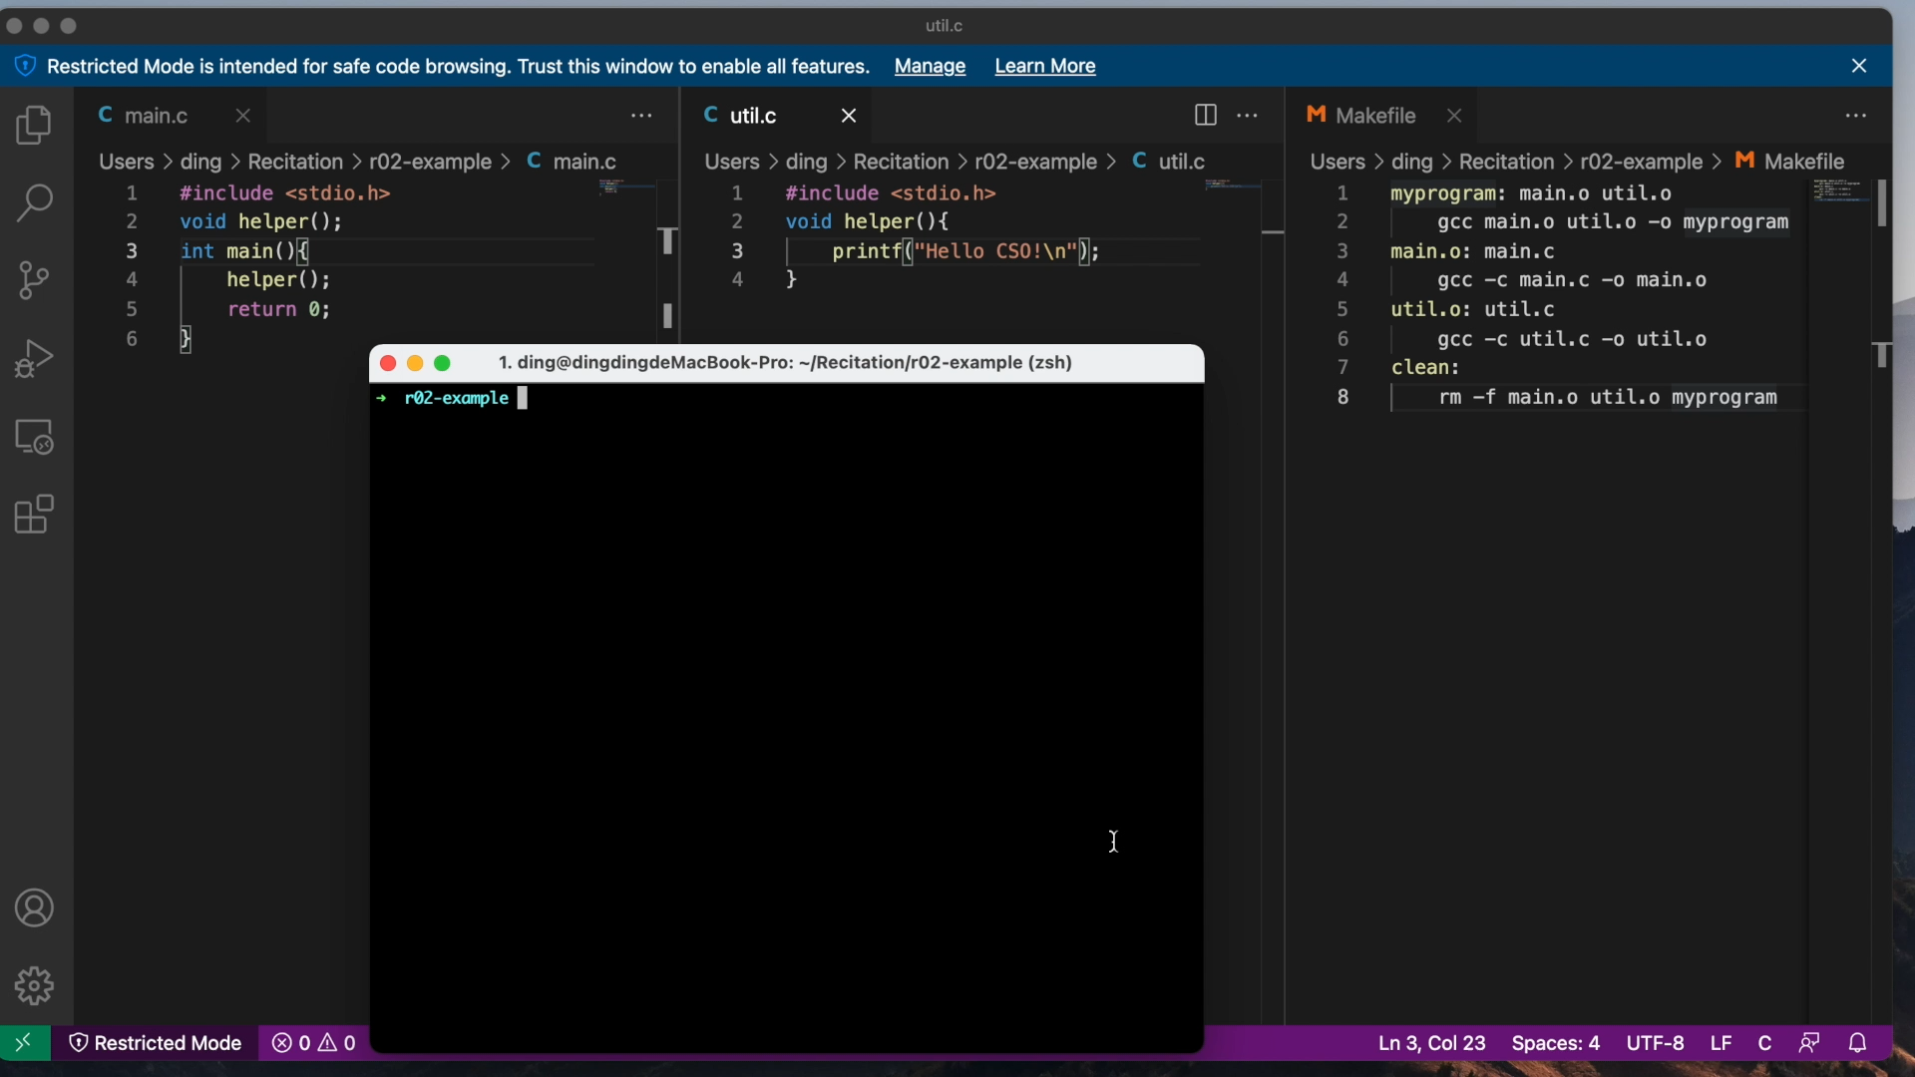
The overall Makefile

Slide 43
Quiz
A bad Makefile for this little project is:
myprogram: main.c util.c
gcc main.c util.c -o myprogram
Why is that bad?

Slide 44
That still seems bad for the 45,000 linux files..
That’s right, and there are better ways of using Makefiles - this is just what you absolutely positively need to know
Make also supports pattern matching with the percent sign %
%.c means all .c files
Make has “automatic variables”
Variables whose meaning within a rule depends on context
$@ is the target name that you are building for this rule
$^ is the list of dependencies
Example:
myprogram: main.o util.o
gcc $^ -o $@
myprogram: main.o util.o
gcc main.o util.o -o myprogram
Equivalent

Slide 45
That still seems bad for the 45,000 linux files..
Example:
myprogram: main.o util.o
gcc main.o util.o –o myprogram
%.o: %.c
gcc -c $^ -o $@
main.o: main.c​
gcc -c main.c -o main.o​
util.o: util.c​
gcc -c util.c -o util.o
Equivalent

Slide 46
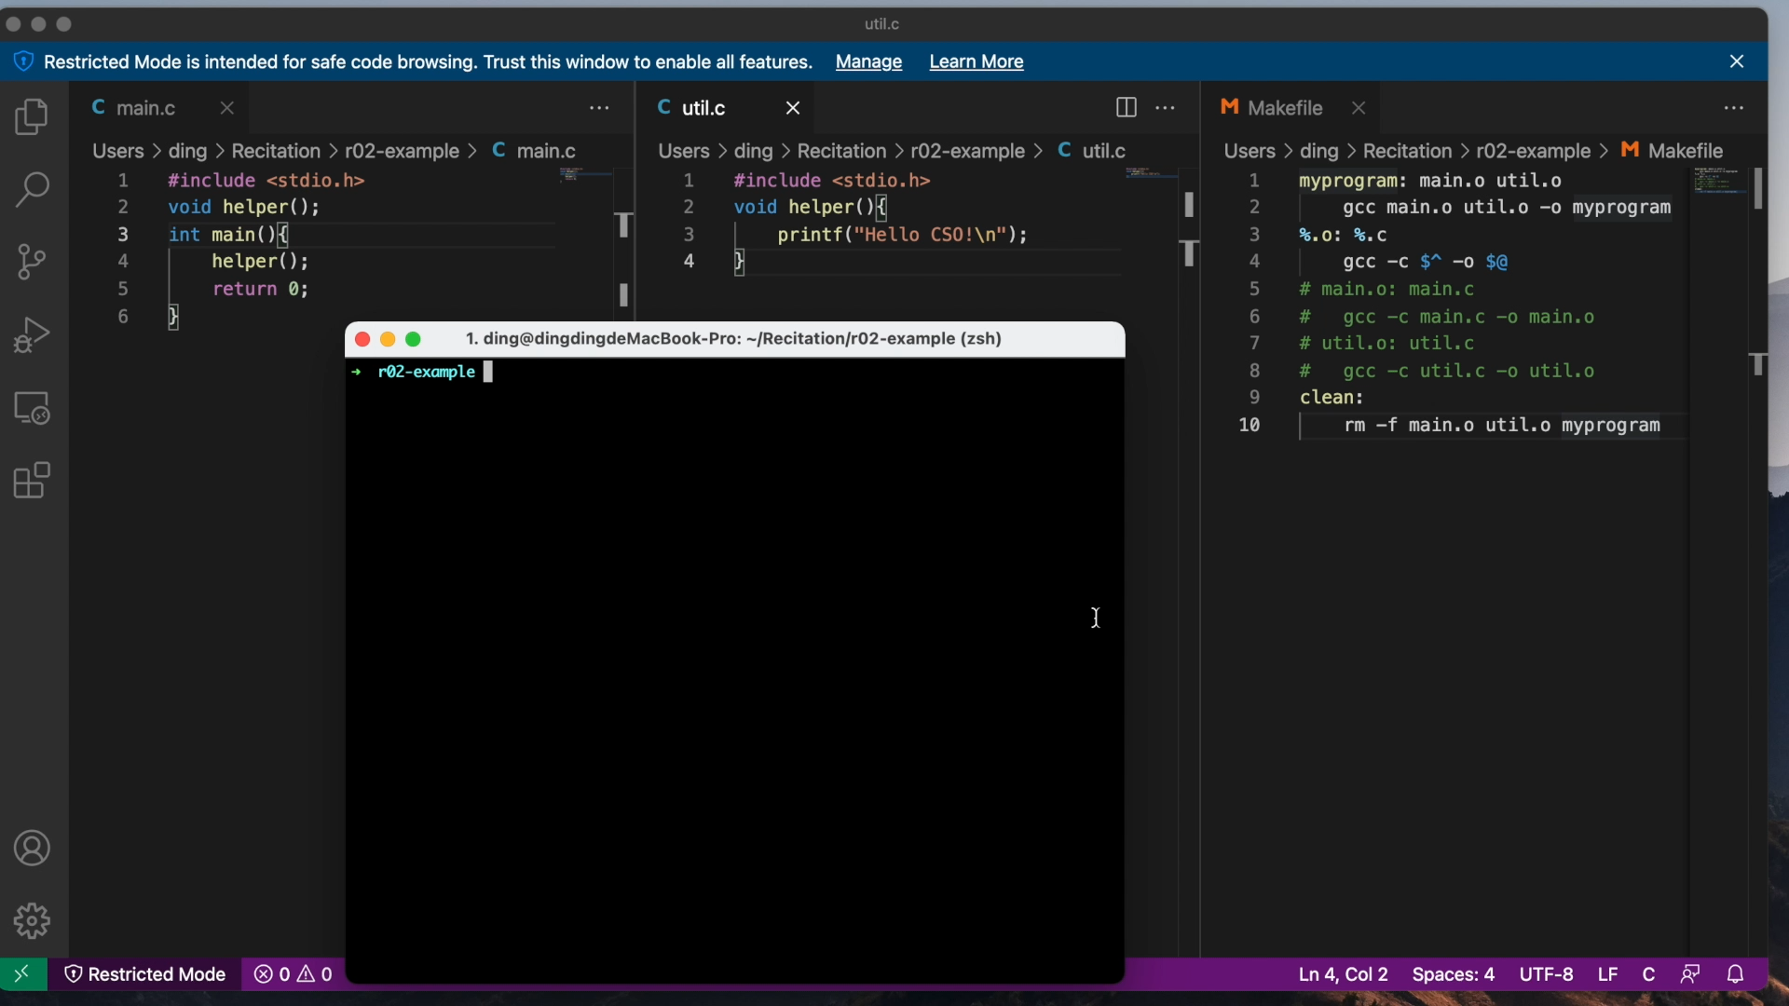
That still seems bad for the 45,000 linux files..

Slide 47
An exercise
#TODO: Create a makefile for this project
#The name of the executable must be test
#The source code files involved are main.c and util.c
#make clean should remove test and any .o files

Slide 48
Testing
Making sure your code does what you think it does

Slide 49
Why test code?
You need to know that your code works
You need to know when you broke your own code by changing something
Many projects actually have more test code than production code
An extreme example is SQLite, a popular database program
138,900 lines of C code for production
91,946,200 lines of test code

Slide 50
How do you test code?
A common way is to write tests for individual units of code, such as functions
There are many frameworks written to help developers write test cases
You can write your own tests
Think of edge cases that might make your code failed
Write a program that calls your code with different inputs and checks that the output is what you’d expect
You can use assert to have your program die if something goes wrong
assert(1+1==2) will crash if 1+1 is not 2, but be fine otherwise

